Slide 1


d
Almaz Sadenov
26 Oct 2021

Slide 2

Outline
Executive Summary
Introduction
Methodology
Results
Conclusion
Appendix

Slide 3
Executive Summary
During the capstone real work pipeline has been simulated, this experience going to be helpful in any future data project.
Pipeline steps included:
Data collection (REST API / web scraping)
Data preparation and cleaning
Data Wrangling using Pandas
Data Visualization using plot/seaborn/folium/plotly libraries
Machine learning alghorithm performing and choosing the best
These capstone project tasks lead you to improve your data science skills

Slide 4
Introduction
Project Background
SpaceX advertises Falcon 9 rocket launches on its website with a cost of 62 million dollars; other providers cost upward of 165 million dollars each, much of the savings is because
SpaceX can reuse the first stage. Therefore if we can determine if the first stage will land, we can determine the cost of a launch.
In this capstone, we will predict if the Falcon 9 first stage will land successfully.

Slide 5


Slide 6
Methodology
Executive Summary
Data collection methodology:
Data was collected and checked that is in the correct format from an API.
Also launch data extracted from HTML table from Wikipedia
Data wrangling
Features created, missing values checked, visualized through pandas dataframe
Exploratory data analysis (EDA) using visualization and SQL
Interactive visual analytics using Folium and Plotly Dash
Predictive analysis using classification models

Slide 7
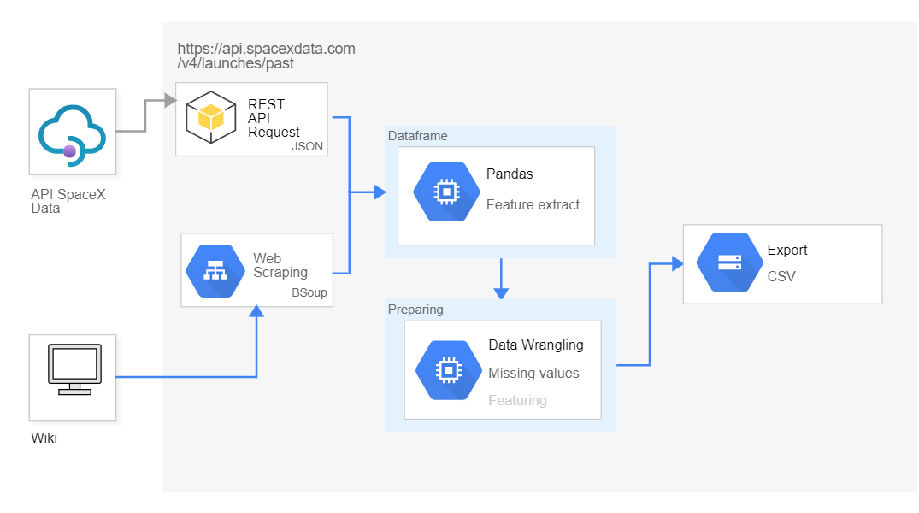
Data Collection

Slide 8
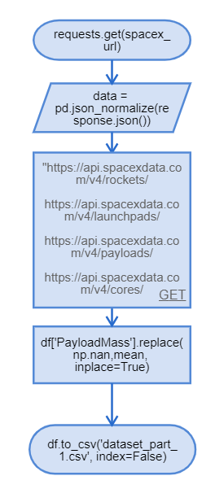
Data Collection – SpaceX API
Data collection with SpaceX REST calls
GitHub URL of the completed SpaceX API calls notebook
https://github.com/alm4z/ibm-ds-capstone/blob/8cdab60ff7a87ed2bcf4b462053d98607dbf94fe/Week%201/Data%20Collection%20API.ipynb
Decode the response content as a Json using json() and turn it into a Pandas dataframe using.json_normalize()
We will now use the API again to get information about the launches using the IDs given for each launch. Specifically we will be using columns
Rocket
Payloads,
Launchpad,
Cores
The mean and the .replace() function to replace `np.nan` values in the data with the mean you calculated.

Slide 9
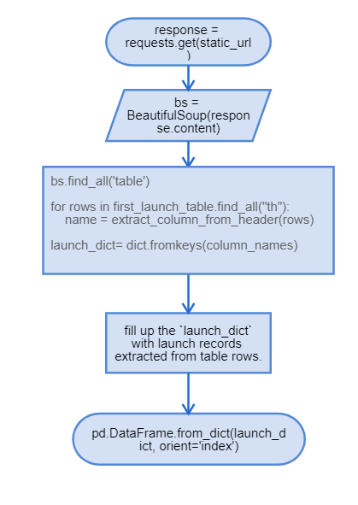
Data Collection – Scraping
Data collection with Web Scraping
GitHub URL of the completed Web Scraping notebook
https://github.com/alm4z/ibm-ds-capstone/blob/8cdab60ff7a87ed2bcf4b462053d98607dbf94fe/Week%201/Data%20Collection%20with%20Web%20Scraping.ipynb
Request the HTML page from the above URL and get a `response` object
Use BeautifulSoup() to create a BeautifulSoup
object from a response text content
Iterate each required html element and apply the provided extract_data() to get a value
Create dataframe and export it to a CSV.

Slide 10
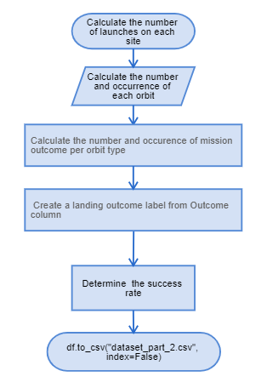
Data Wrangling
Data was processed using pandas dataframe features
Data wrangling process contains 5 steps for data understanding
GitHub URL of completed data wrangling related notebook
https://github.com/alm4z/ibm-ds-capstone/blob/8cdab60ff7a87ed2bcf4b462053d98607dbf94fe/Week%202/EDA.ipynb

Slide 11
EDA with Data Visualization
Scatter Point Charts:
The relationship between Flight Number and Launch Site
The relationship between Payload and Launch Site
The relationship between Payload and Orbit type
Bar Chart
The relationship between success rate of each orbit type
Line Chart
The launch success yearly trend¶
https://github.com/alm4z/ibm-ds-capstone/blob/8cdab60ff7a87ed2bcf4b462053d98607dbf94fe/Week%202/EDA%20with%20Data%20Visualization.ipynb

Slide 12
EDA with SQL
Performed SQL queries:
The names of the unique launch sites in the space mission
5 records where launch sites begin with the string 'CCA'
Average payload mass carried by booster version F9 v1.1
List of the first successful landing outcome in ground pad was acheived.
List of the names of the boosters which have success in drone ship and have payload mass greater than 4000 but less than 6000
List of the total number of successful and failure mission outcomes
List of the names of the booster_versions which have carried the maximum payload mass. Use a subquery
List of the failed landing_outcomes in drone ship, their booster versions, and launch site names for in year 2015
Ranked count of landing outcomes (such as Failure (drone ship) or Success (ground pad)) between the date 2010-06-04 and 2017-03-20, in descending order
https://github.com/alm4z/ibm-ds-capstone/blob/8cdab60ff7a87ed2bcf4b462053d98607dbf94fe/Week%202/EDA%20with%20SQL.ipynb

Slide 13
Build an Interactive Map with Folium
Next Folium maps were generated:
All launch sites were marked on a map¶
The success/failed launches were marked for each site on the map
The distances between a launch site to its proximities¶
These maps helped to understand distance relationship between launches
https://github.com/alm4z/ibm-ds-capstone/blob/8cdab60ff7a87ed2bcf4b462053d98607dbf94fe/Week%203/Interactive%20Visual%20Analytics%20with%20Folium%20lab.ipynb

Slide 14
Build a Dashboard with Plotly Dash
Next elements and functions were coded:
Dropdown list to enable Launch Site selection
Pie chart to show the total successful launches count for all sites
Slider to select payload range
Scatter chart for success payload
Callback function for `site-dropdown` as input, `success-pie-chart` as output
Callback function for `site-dropdown` and `payload-slider` as inputs, `success-payload-scatter-chart` as output
Interactive dash helps to understand relationship between payload and success launches count in different circumstances
https://github.com/alm4z/ibm-ds-capstone/blob/8cdab60ff7a87ed2bcf4b462053d98607dbf94fe/Week%203/spacex_dash_app.py

Slide 15
Predictive Analysis (Classification)
Performed exploratory Data Analysis and determined Training Labels
Created a column for the class
Standardized the data
Splited into training data and test data
Finded best Hyperparameter for SVM, Classification Trees and Logistic Regression
Selected the method performs best using test data
https://github.com/alm4z/ibm-ds-capstone/blob/8cdab60ff7a87ed2bcf4b462053d98607dbf94fe/Week%204/Machine%20Learning%20Prediction.ipynb

Slide 16
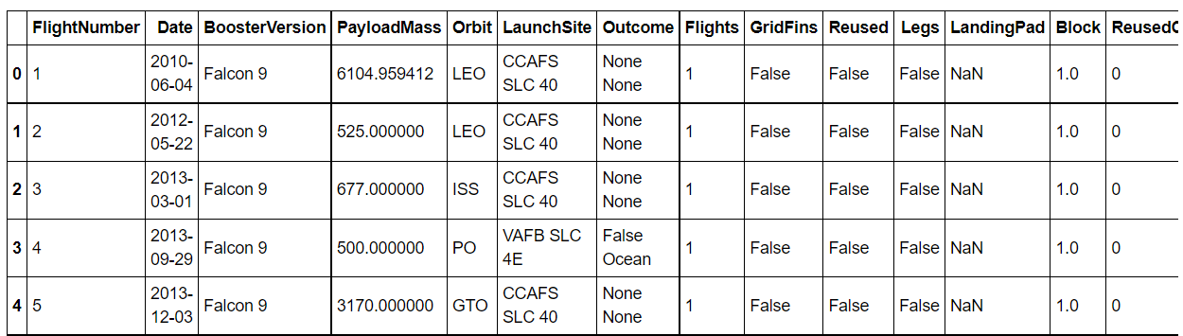
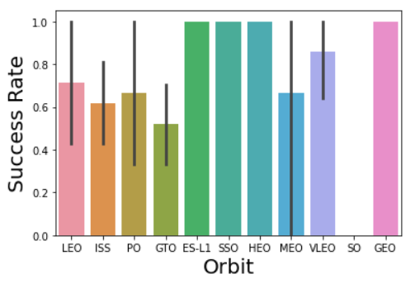
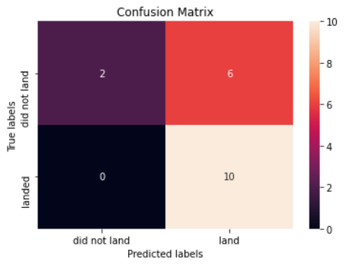
Results

Slide 17


Slide 18
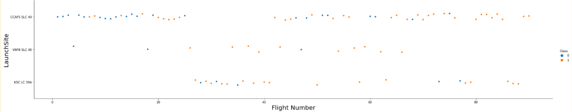
Flight Number vs. Launch Site
A significant part of launches started from CCAFS SLC 40

Slide 19
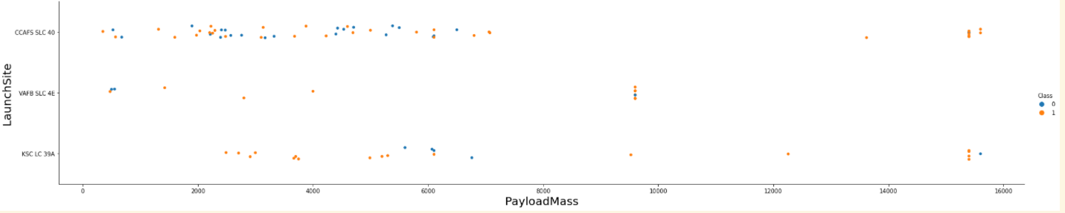
Payload vs. Launch Site
Median payload mass related to CCAFS SLC 40

Slide 20
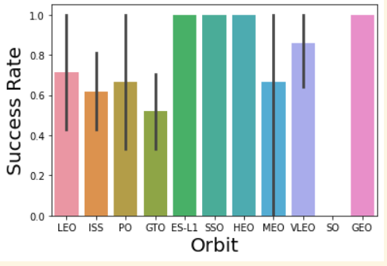
Success Rate vs. Orbit Type
100% success rate observed in ES-L1/SSO/HEP and GEO orbit types

Slide 21
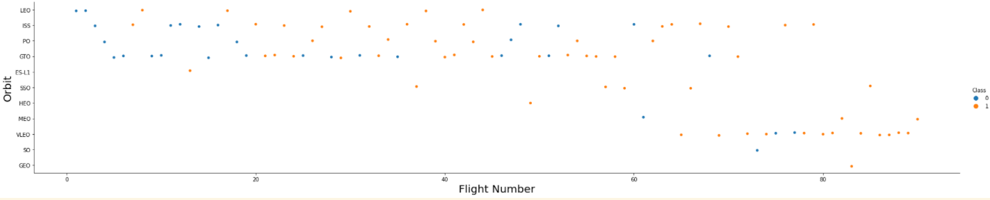
Flight Number vs. Orbit Type
First 60 flights were launched to LEO/ISS/PO/GEO/ES-l1 orbit types, in the end of observed period the most frequent orbits are MEO/VLEO/SO/GEO

Slide 22
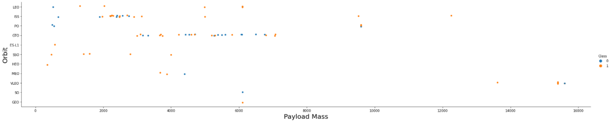
Payload vs. Orbit Type
GEO is the most frequently used orbit for any payload mass

Slide 23
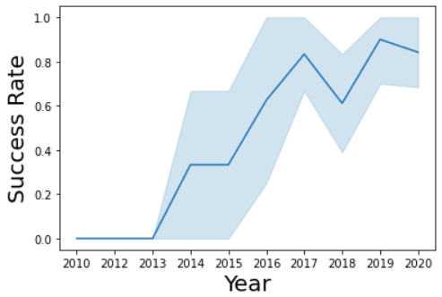
Launch Success Yearly Trend
Success rate showed an incredible rise during the all period of time

Slide 24
All Launch Site Names
CCAFS LC-40
CCAFS SLC-40
KSC LC-39A
VAFB SLC-4E
SQL query, launch_site selected using grouping :
select LAUNCH_SITE from SPACEXTBL group by LAUNCH_SITE

Slide 25
Launch Site Names Begin with 'CCA'
DATE | time__utc_ | booster_version | launch_site | payload | payload_mass__kg_ | orbit | customer | mission_outcome | landing__outcome
2010-06-04 | 18:45:00 | F9 v1.0 B0003 | CCAFS LC-40 | Dragon Spacecraft Qualification Unit | 0 | LEO | SpaceX | Success | Failure (parachute)
2010-12-08 | 15:43:00 | F9 v1.0 B0004 | CCAFS LC-40 | Dragon demo flight C1, two CubeSats, barrel of Brouere cheese | 0 | LEO (ISS) | NASA (COTS) NRO | Success | Failure (parachute)
2012-05-22 | 07:44:00 | F9 v1.0 B0005 | CCAFS LC-40 | Dragon demo flight C2 | 525 | LEO (ISS) | NASA (COTS) | Success | No attempt
2012-10-08 | 00:35:00 | F9 v1.0 B0006 | CCAFS LC-40 | SpaceX CRS-1 | 500 | LEO (ISS) | NASA (CRS) | Success | No attempt
2013-03-01 | 15:10:00 | F9 v1.0 B0007 | CCAFS LC-40 | SpaceX CRS-2 | 677 | LEO (ISS) | NASA (CRS) | Success | No attempt
SQL query
select * from SPACEXTBL where LAUNCH_SITE LIKE 'CCA%' LIMIT 5

Slide 26
Total Payload Mass
45 596
SQL query:
SELECT sum(payload_mass__kg_) from spacextbl where customer='NASA (CRS)'

Slide 27
Average Payload Mass by F9 v1.1
2 928
SQL query:
SELECT AVG(payload_mass__kg_) from spacextbl where booster_version='F9 v1.1'

Slide 28
First Successful Ground Landing Date
2015-12-22
SQL query:
select min(DATE) from spacextbl where landing__outcome = 'Success (ground pad)'

Slide 29
Successful Drone Ship Landing with Payload between 4000 and 6000
booster_version
F9 FT B1022
F9 FT B1026
F9 FT B1021.2
F9 FT B1031.2
SQL query:
select booster_version from spacextbl where landing__outcome = 'Success (drone ship)' and payload_mass__kg_ between 4000 and 6000

Slide 30
Total Number of Successful and Failure Mission Outcomes
mission_outcome
Failure (in flight) | 1
Success | 99
Success (payload status unclear) | 1
SQL query:
select mission_outcome, count(*) from spacextbl group by mission_outcome

Slide 31
Boosters Carried Maximum Payload
F9 B5 B1048.4 | 15600
F9 B5 B1049.4 | 15600
F9 B5 B1051.3 | 15600
F9 B5 B1056.4 | 15600
F9 B5 B1048.5 | 15600
F9 B5 B1051.4 | 15600
F9 B5 B1049.5 | 15600
F9 B5 B1060.2 | 15600
F9 B5 B1058.3 | 15600
F9 B5 B1051.6 | 15600
F9 B5 B1060.3 | 15600
F9 B5 B1049.7 | 15600
SQL query:
select booster_version,payload_mass__kg_ from spacextbl where payload_mass__kg_ in (select max(payload_mass__kg_) from spacextbl)

Slide 32
2015 Launch Records
booster_version | launch_site
F9 v1.1 B1012 | CCAFS LC-40
F9 v1.1 B1015 | CCAFS LC-40
SQL query:
select booster_version,launch_site from spacextbl where landing__outcome='Failure (drone ship)' and year(date)=2015

Slide 33
Rank Landing Outcomes Between 2010-06-04 and 2017-03-20
Failure (drone ship) | 5
Success (ground pad) | 3
SQL query:
select landing__outcome,count(*) from spacextbl where landing__outcome in ('Failure (drone ship)','Success (ground pad)') and date between '2010-06-04' and '2017-03-20' group by landing__outcome

Slide 34


Slide 35
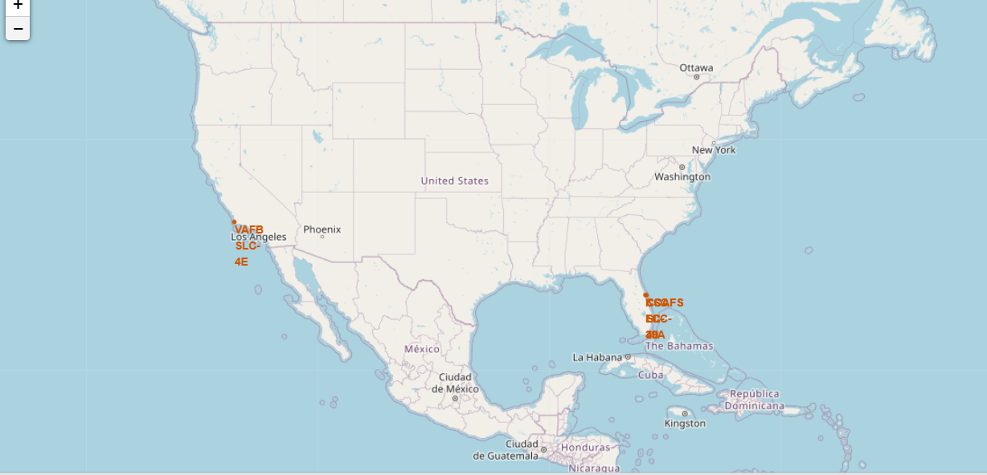
<Folium Map Screenshot 1>

Slide 36
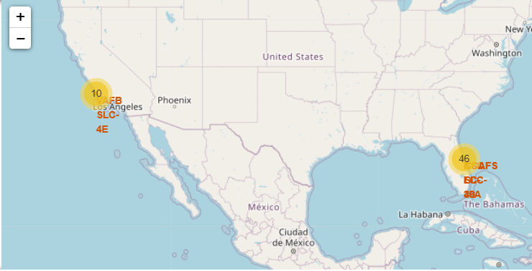
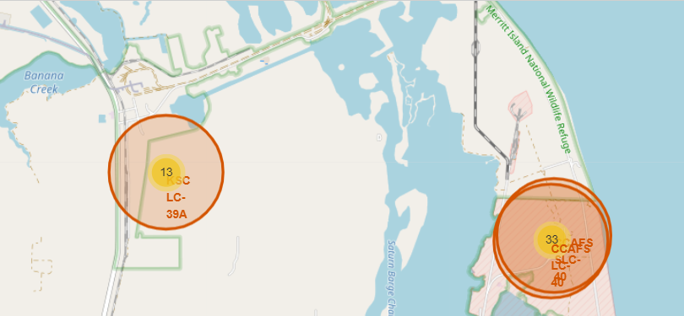
<Folium Map Screenshot 2>

Slide 37
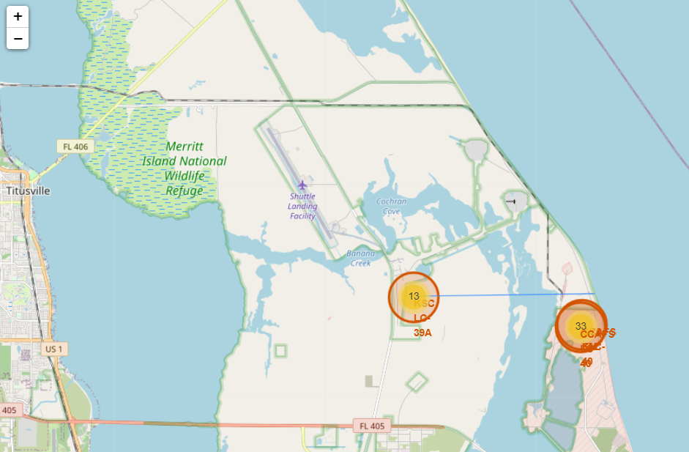
<Folium Map Screenshot 3>

Slide 38


Slide 39
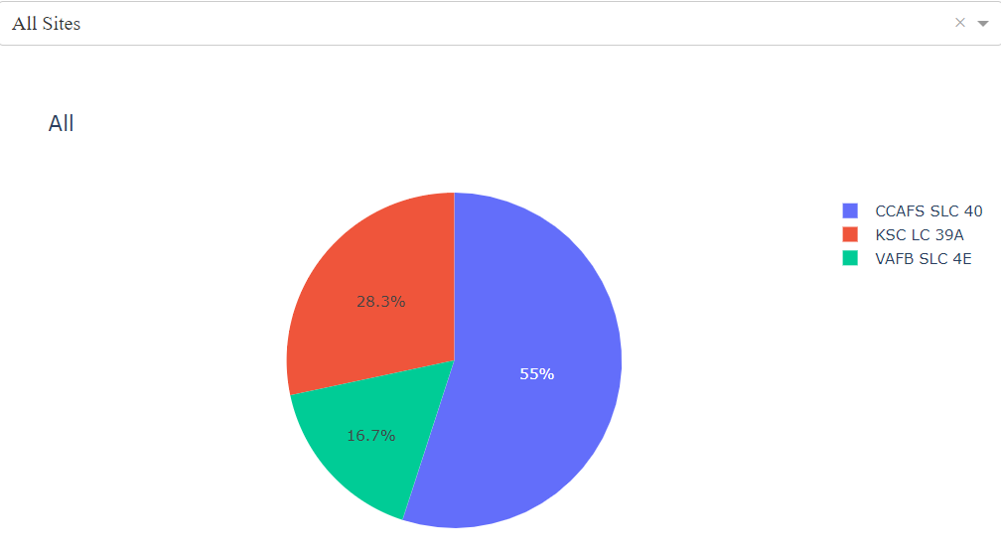
<Dashboard Screenshot 1>

Slide 40
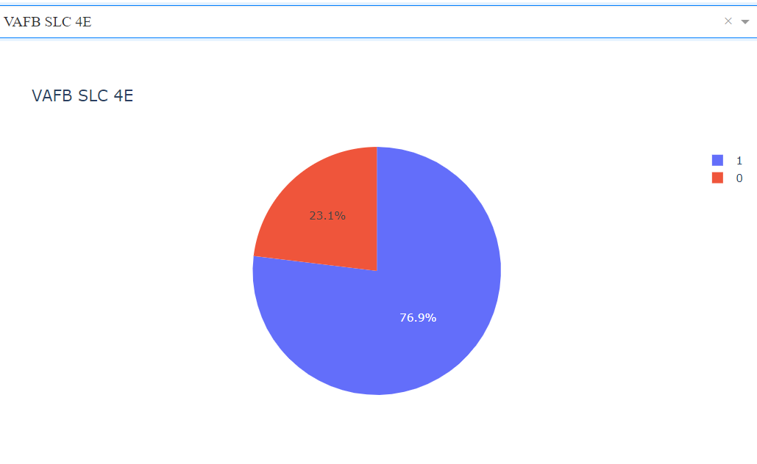
<Dashboard Screenshot 2>

Slide 41
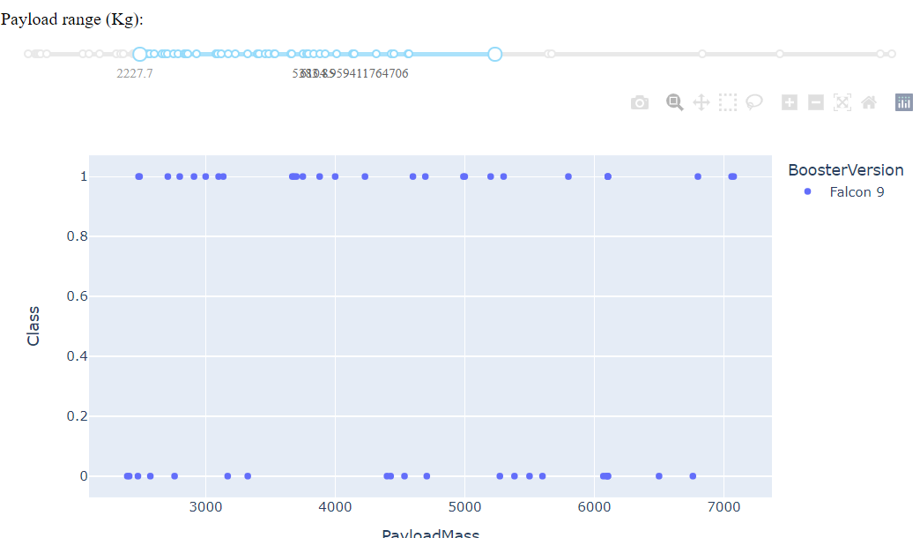
<Dashboard Screenshot 3>

Slide 42


Slide 43
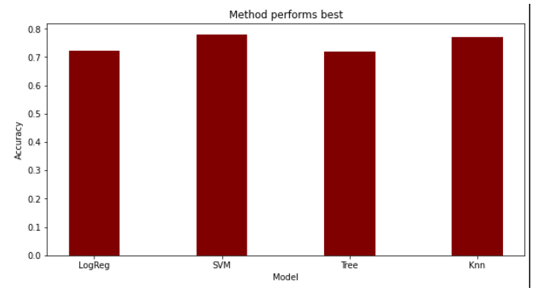
Classification Accuracy
Best accuracy on test data - SVM

Slide 44
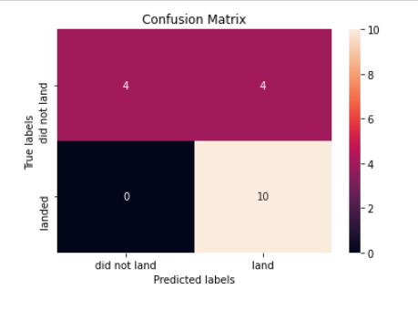
Confusion Matrix

Slide 45
Conclusions
Space X advertises Falcon 9 rocket launches on its website with a cost of 62 million dollars;
Therefore now we can determine if the first stage will land, we can determine the cost of a launch.
This information can be used if an alternate company wants to bid against space X for a rocket launch.
In this lab, we have been created a machine learning pipeline to predict if the first stage will land given the data from the preceding labs.

Slide 46
Appendix
How to autofill dropdown with categories
dcc.Dropdown(id='site-dropdown',
options=[{'label': 'All Sites', 'value': 'ALL'}] +
[ {'label': i, 'value': i} for i in
spacex_df['LaunchSite'].unique().tolist() ],
value='ALL',
placeholder="Select a Launch Site here",
searchable=True)

Slide 47


